Slide 1
Behaviour Driven Development
Or “how I learned to stop worrying and love the business”
Andy Kelk
@andykelk @iproperty_it

Slide 2
All the Ds -> TDD, DDD, BDD
Test Driven Development (or Design)
Write tests first, then write your code, then refactor
When all of your tests pass, you’re done
Domain Driven Design
A common language between “tech” and “biz”
The code structures and product elements align
Behaviour Driven Development
Eliminates the gap between business expectations and development output
Uses business language to test software
“Executable specs”

Slide 3
What is BDD?
A way of writing tests using natural language that business stakeholders can understand
Feature: Search results
In order to find some listings
As a consumer
I want to do a search
Scenario: I do a default search
Given I am on the homepage
When I click "Search"
Then I will see 10 listings

Slide 4
Why natural language?
Collaboration
The business folk understand what the tech folk are doing and can see what is being developed
Self-documenting
The tests are the specification; they are updated as the implementation changes; they are known to be correct.
Ubiquitous language
Is it a “property” or a “listing”, an “agent” or an “agency”?

Slide 5
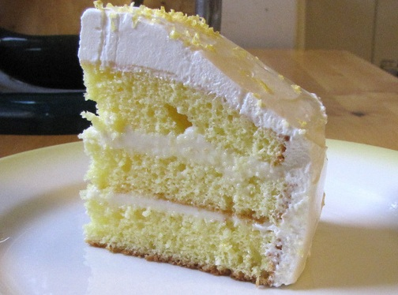
How does it deliver business value?
Encourages “full-slice” development
Full
slice
UI
Display the date
“As a user, so that I can decide if a property suits my needs, I want to be able to view the date it was built”
Front end database
Add a field for the date
Replication layer
Replicate the date field
Back end database
Add a field for the date
Data entry system
Allow date to be added
http://www.flickr.com/photos/litlnemo/4159389584/

Slide 6
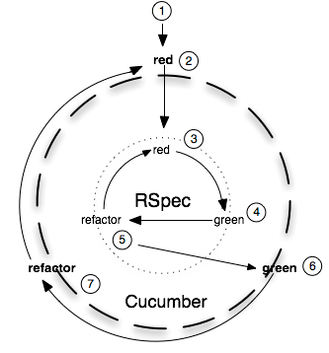
How does it fit with the development process?
Involves QA from day 1 – they can be pairing with devs to write the tests
Integrates with TDD:
Red
Green
Refactor
Integrates with continuous integration; can be used when implementing continuous deployment

Slide 7
BDD in action: Cucumber features
Cucumber is a BDD framework written in Ruby
Using Capybara and Selenium, you can test a web page
Here’s a simple example feature file:
Feature: Search results
In order to find some listings
As a consumer
I want to do a search
Scenario: I do a default search
Given I am on the homepage
When I click "Search"
Then I will see 10 listings

Slide 8
BDD in action: the steps
Step definitions convert the feature to executable code:
Given /^I am on the homepage$/ do
visit('http://www.iproperty.com.sg/')
end
When /^I click "([^\"]*)"$/ do |button|
click_on(button)
end
Then /^I will see (\d+) listings$/ do |expected_num|
all(".searchlistingtitle").count.should == expected_num.to_i
end
Capybara
regular expression
Capybara
regular expression
Capybara
assertion

Slide 9
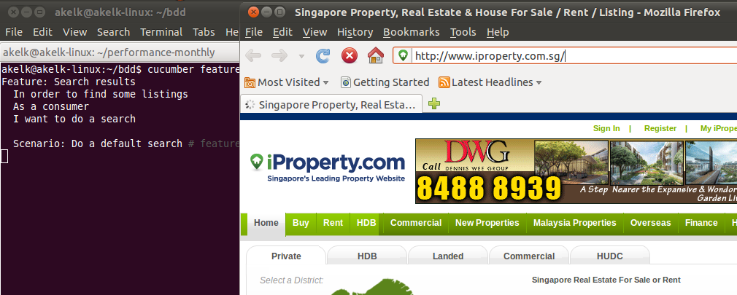
BDD in action: running the test
Capybara drives Selenium to launch a browser for testing:

Slide 10
BDD in action: results
And our tests pass:
$ cucumber features
Feature: Search results
In order to find some listings
As a consumer
I want to do a search
Scenario: Do a default search # features/search.feature:6
Given I am on the homepage # features/step_definitions/steps.rb:4
When I click "Search" # features/step_definitions/steps.rb:8
Then I will see 10 listings # features/step_definitions/steps.rb:12
1 scenario (1 passed)
3 steps (3 passed)
0m35.449s

Slide 11
The language: Given
The given clause sets up the initial state for the scenario we are testing.
As such, it may interact with the system
But should not perform interactions relevant to the scenario itself
Also it should be expressed as a pre-existing condition
But should not be expressed like an action
Given a registered user 'bob'
Source: http://www.jroller.com/perryn/entry/given_when_then_and_how

Slide 12
The language: When
The when clause describes the things that the user (or some other actor) does to the system.
As such, it should describe what the user does
But should not describe things that the system does
The and clause can be used as a synonym to avoid repeating when
When a user navigates to the Sign In page And the user signs in as 'bob'
Source: http://www.jroller.com/perryn/entry/given_when_then_and_how

Slide 13
The language: Then
The then clause describes the things that the system is expected to do. (in response to something done in a when clause)
As such, it should describe what the system should do
But should not describe things that the user does
Then the profile page for 'bob' will be displayed
Source: http://www.jroller.com/perryn/entry/given_when_then_and_how

Slide 14
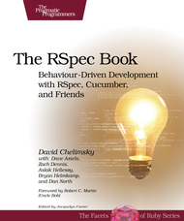
Resources
http://dannorth.net/introducing-bdd/
http://cukes.info/ - written in Ruby
http://jbehave.org/ - written in Java
http://www.specflow.org/ - written in .Net
http://www.pragprog.com/titles/achbd/the-rspec-book
Agile Malaysia Group: http://www.meetup.com/Agile-Malaysia/
Andy Kelk: @andykelk @itproperty_it

